Slide 1

MARKETING 4.0
Moving from Traditional to Digital
Hermawan Kartajaya
Founder and Chairman of MarkPlus, Inc.
Founder of Asia Marketing Federation

Slide 2
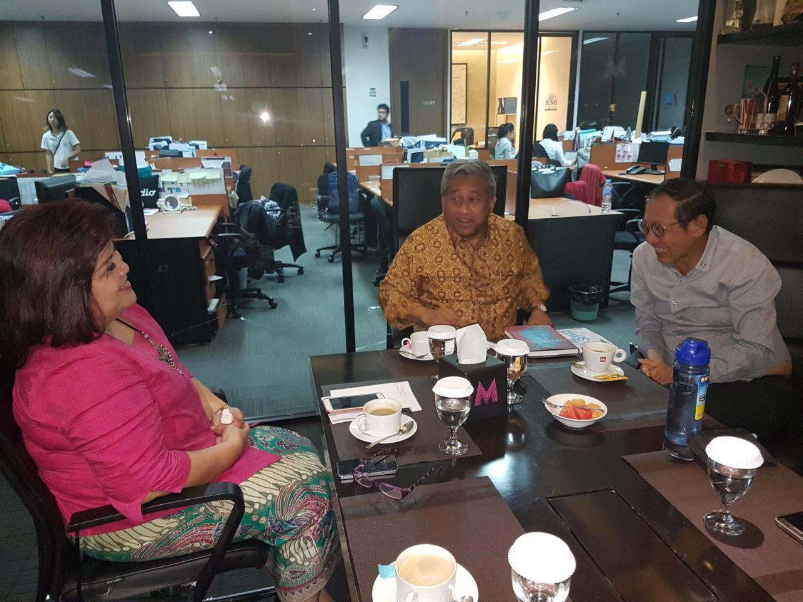




Slide 3







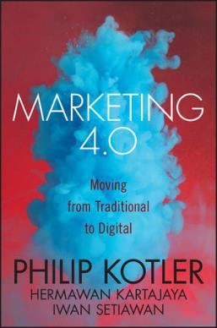
About Hermawan Kartajaya’s International Books

Slide 4

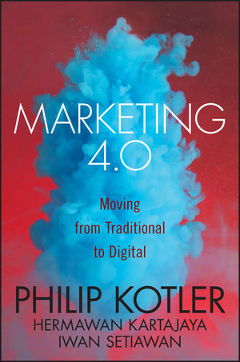
By John Wiley
Launched at
MarkPlus Conference 2017
Available in 21 Languages
By John Wiley – US 2010
Available in 27 languages

Slide 5











Customer Path: From Individual to Social
Appeal
Attitude
Ask
Act
Advocate
Aware
Act Again

Slide 6


